Slide 1

Medical test recommendation system using the patient symptoms “GB-Medibot”
Group members:
1- Shoaib ud-din G1
2- liliyom G3
3-Ania shams G3

Slide 2
Problem statement:
We observe that individuals do not care about their health at all and do not have the patience to go through the process of meeting a doctor in hospitals i.e., reaching the hospital, making an appointment, waiting for hours .
We can be able to diagnose a disease by just entering a symptoms to our model

Slide 3
Steps to follow:
Here the steps that we are going to follow:
Data collection and creating Dataset.
Preprocess the Data.
Apply ML model and test its accuracy.
We will use pre-trained model of bard or Gpt-3 to optimize our model.
Fine-tune.
Testing
Developing to user interface

Slide 4
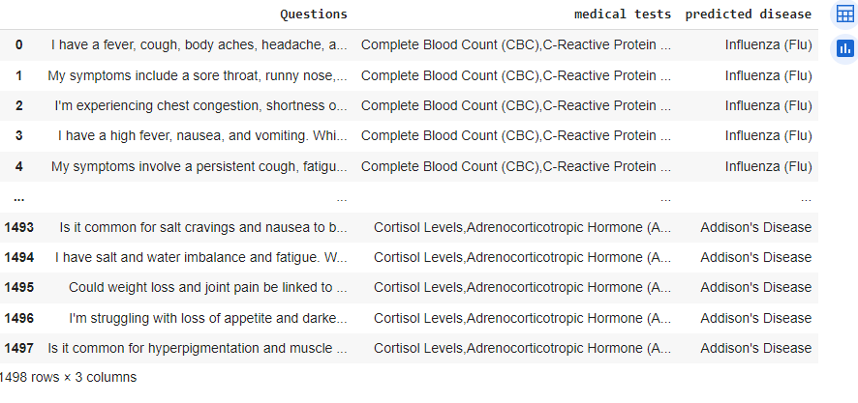
Dataset:

Slide 5
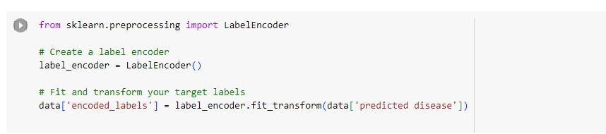
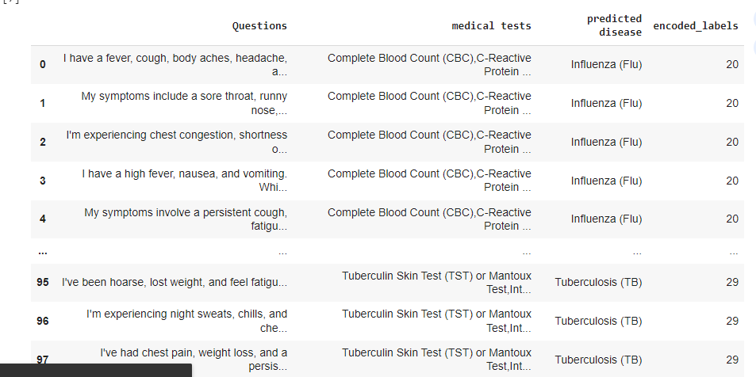
Label encoding:

Slide 6
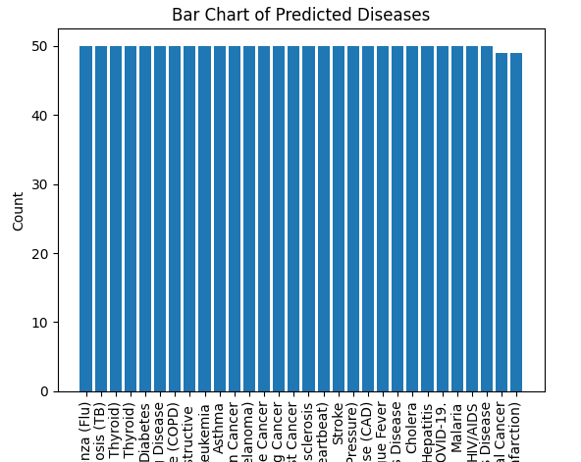
Dataset Overview and Exploratory Data Analysis (EDA):

Slide 7
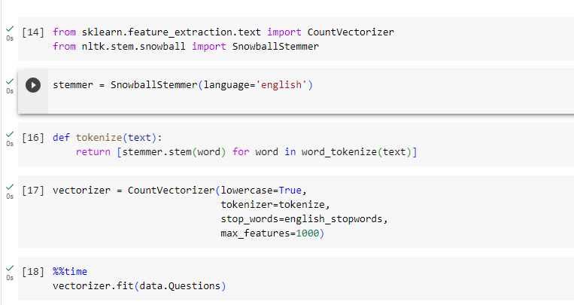

1-count vectorizer 2-bag of words

Slide 8
Model Selection and Justification:
First, we use ML model (logistic regression of multi-classification)
The accuracy is high but this model do not create any relation between the series of words.
Now we are going to use bart which is pretrained model on large amount of data, and is a transformer-based model.

Slide 9
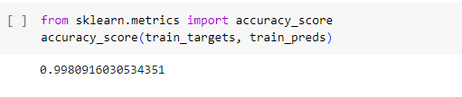
Results:

Slide 10
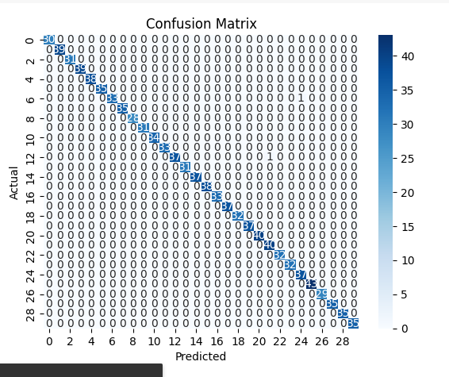
Confusion matrix:

Slide 11
Streamlit:
Streamlit can provide a user-friendly interface, building a chatbot still involves robust NLP and AI components to understand and respond to user input effectively.

Slide 12
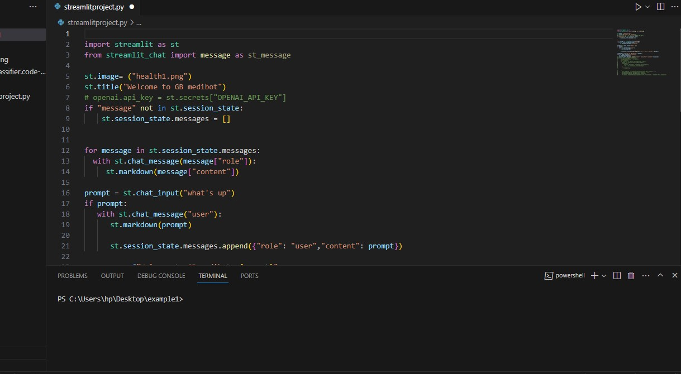

Slide 13
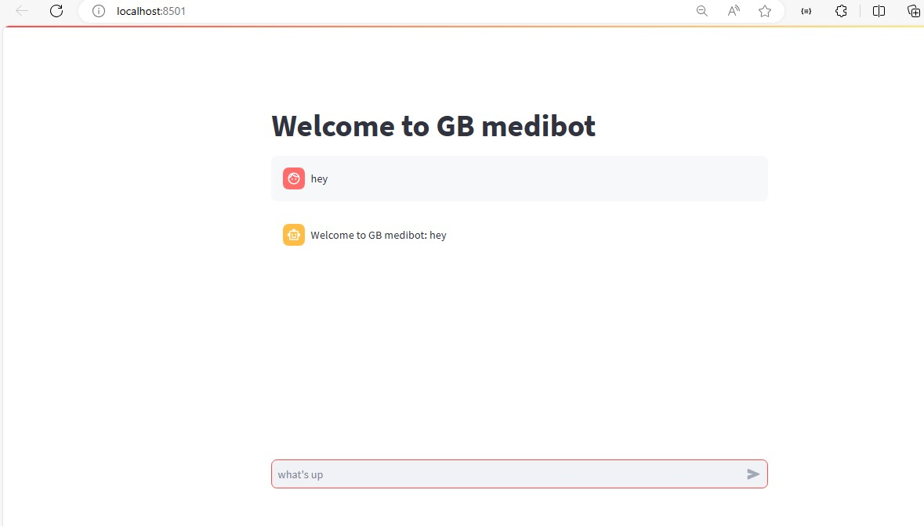

Slide 14
References:
https://doi.org/10.1109/ComPE53109.2021.9751805

Slide 15


